Slide 1
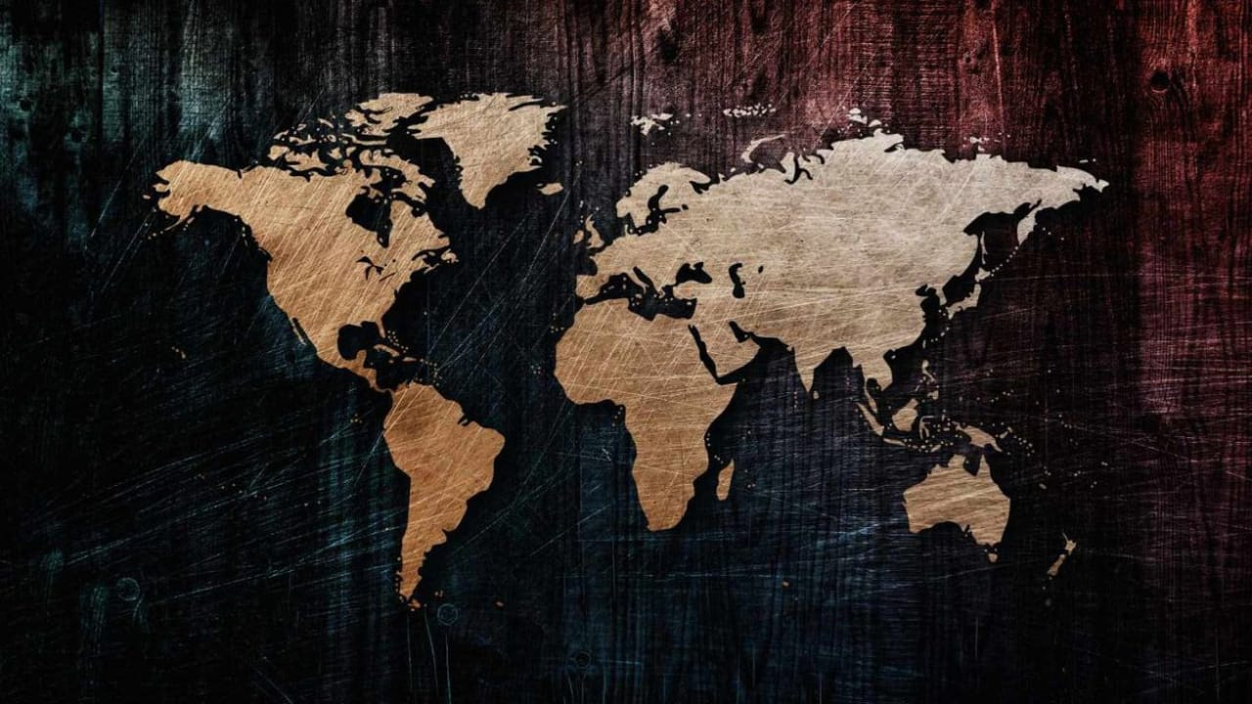
CENSUS OF INDIA (2011)
DATA ANALYSIS
PRESENTED BY:
SHUBHAM UPADHYAY
PROJECT FILE:CENSUS OF INDIA

Slide 2
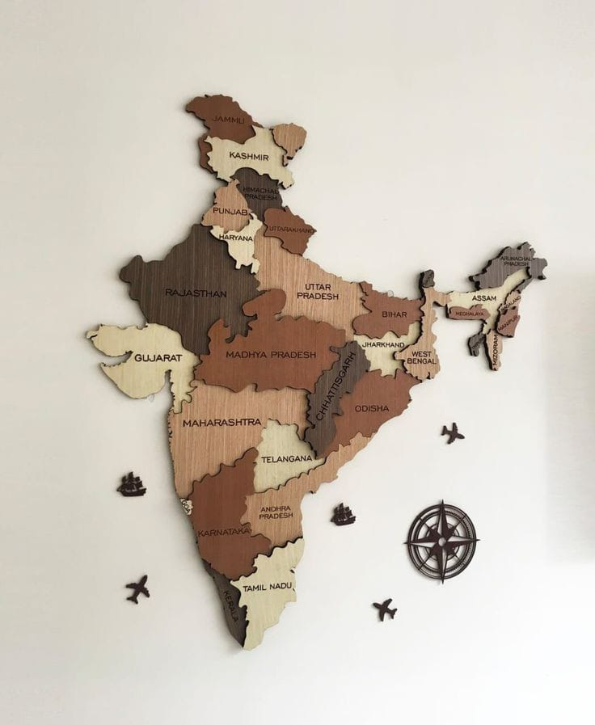
AGENDA
INTRODUCTION
PROBLEM STATEMENT
DEFINE QUESTIONS
KEY INSIGHT
CONCLUSION

Slide 3
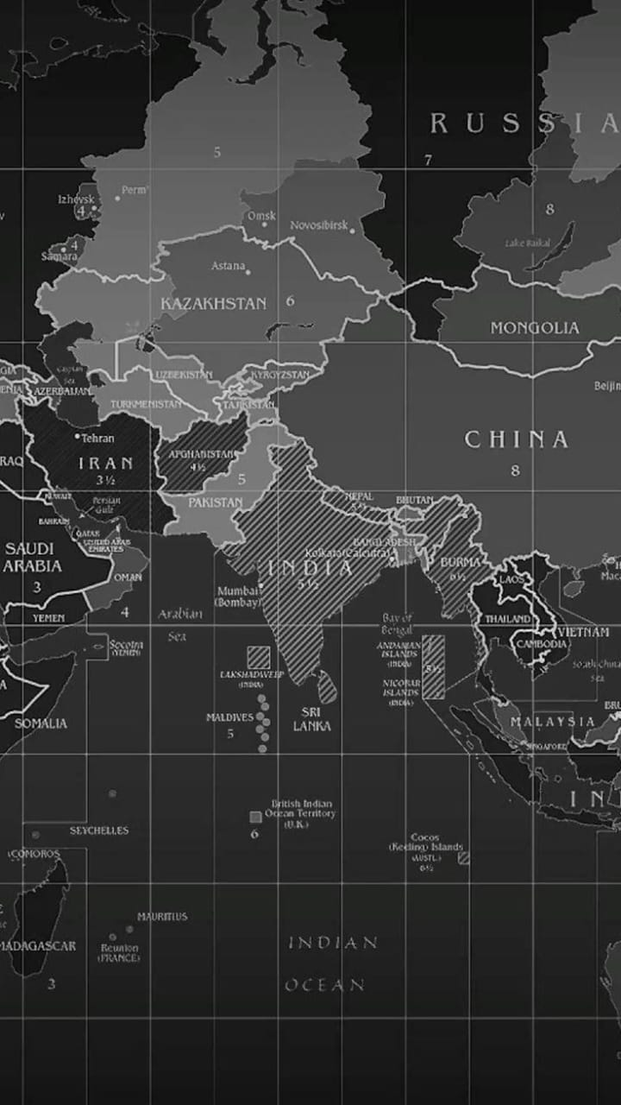
INTRODUCTION
This dataset provides comprehensive demographic information for various districts in India. It includes data on population, growth rates, sex ratios, and literacy rates. The dataset offers insights into the socio-economic landscape of Indian districts, making it valuable for demographic analyses, regional studies, and decision-making processes.

Slide 4

PROBLEM STATEMENT
What is India's position regarding its sex ratio and literacy rate? Additionally, what is the rationale for analysing this dataset? Finally, please summarise all the key parameters associated with it.

Slide 5

DEFINE QUESTIONS
1. What state had the highest literacy rate?
2. What district had the highest literacy rate?
3. What state had the highest sex ratio?
4. What District had the highest sex ratio?

Slide 6

1. What state had the highest literacy rate?
In 2011, Mizoram emerged as the state with the highest literacy rate in India, boasting an impressive figure of approximately 97.91%. This remarkable achievement highlights the state's commitment to education and the efforts made to promote literacy among its residents.

Slide 7
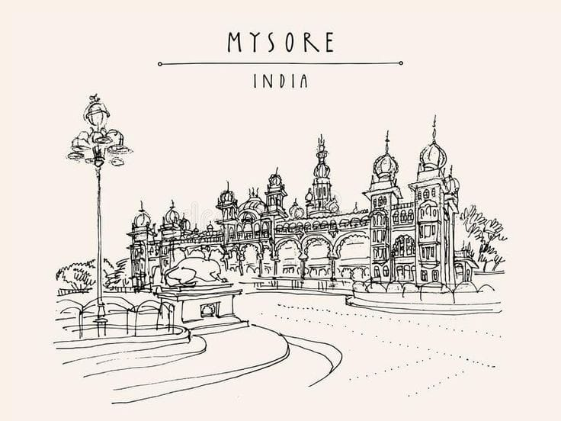
2. What district had the highest literacy rate?
This dataset reveals that the Serchhip District of Mizoram achieved the highest literacy rate in India in 2011which is around 97.91%. This remarkable statistic reflects the successful efforts and initiatives in education within the area, highlighting the commitment to improving literacy and learning opportunities for its residents.

Slide 8

3. What state had the highest sex ratio?
In 2011, Puducherry boasted the highest sex ratio in India, with an impressive figure of approximately 1184 females for every 1000 males. This remarkable statistic not only highlights the region's demographic balance but also suggests a lower rate of abortions compared to other areas, reflecting a healthier societal attitude towards female births.

Slide 9


4. What District had the highest sex ratio?
Mahe District in Puducherry had the highest sex ratio in India in 2011. which is around 1184 females per 1000 males. This remarkable statistic not only highlights the region's demographic balance but also suggests a lower rate of abortions compared to other areas, reflecting a healthier societal attitude towards female births.

Slide 10
Some of the key findings from this dataset are as follows:
Mizoram had the highest literacy rate in 2011, at 97.91%.
Serchhip district in Mizoram recorded the highest literacy rate, also at 97.91%.
Puducherry had the highest sex ratio in 2011, with 1,184 females for every 1,000 males.
Mahe, a district in Puducherry, also had the highest sex ratio in 2011, at 1,184 females for every 1,000 males.

Slide 11
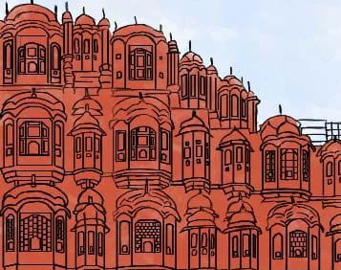
CONCLUSION
The Census of India represents a vital dataset that offers in-depth insights into the demographics, social structure, and economic conditions of the nation. By analyzing this comprehensive information, we can uncover numerous details about the diverse population of India, including patterns of migration, education levels, and employment trends, which are essential for informed policymaking and development planning.

Slide 12
THANKYOU

